Slide 1
Small Bodies in the Solar System

Slide 2
Learning Objectives
I can explain the differences between comets, asteroids, and meteors.
I can explain the differences between meteors, meteorites, and meteoroids.

Slide 3
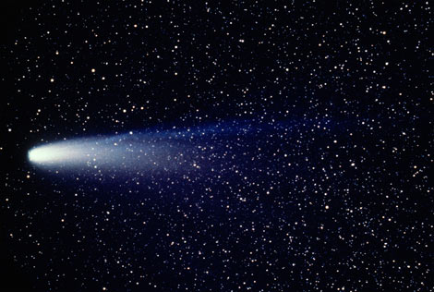
Small Bodies
In addition to planets & moons, the solar system contains many other types of objects, including comets, asteroids, and meteoroids.
We call these small planetary bodies.
Some of them even get pretty close to Earth!
This is Halley’s Comet.

Slide 4
Small Bodies
Comets
Asteroids
Meteors

Slide 5
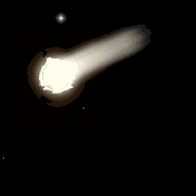
Comet Animation

Slide 6
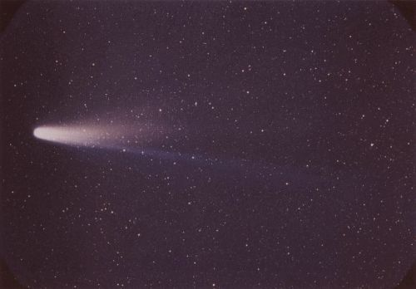
Comets
A comet is a small ball of ice, rock and dust mixed with frozen water, methane, and ammonia that flies through space.
Because of their composition, nicknamed “dirty snowballs”
Very small

Slide 7
Size of Comets
About the size of a mountain. (w/out the tail)
Tails can be ≥ 100 million km

Slide 8
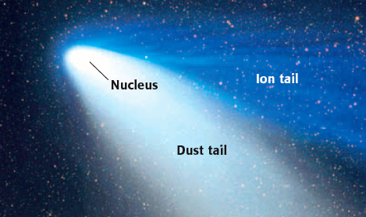
Comet Structure
When a comet gets close to the sun, the heat melts some of the ice in the comet and forms a long tail.
The comet is made out of several parts: the nucleus, dust tail, and ion tail.
The ion tail is made of electrically charge particles that are blown directly away from the sun by the solar wind.

Slide 9
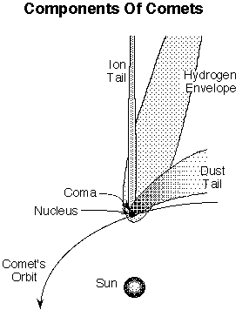
Comet Structure
Nucleus – relatively solid and stable. Center of comet mostly ice and gas with a small amount of other solids.
Dust Tail - up to 10 million km long composed of smoke-sized dust particles driven off the nucleus by escaping gases; this is the most prominent part of a comet to the unaided eye;

Slide 10
Comet Structure
Coma – Dense cloud of water, carbon dioxide, and other neutral gases. Surround the nucleus.
Ion Tail -; made of electrically charge particles that are blown directly away from the sun by the solar wind.

Slide 11
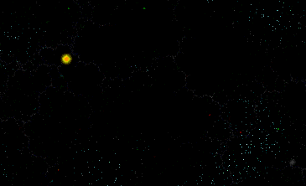
Comet Orbits
All comet orbits are ellipses, or stretched, narrow circles.
They sometimes cross the orbits of several planets on their trip around their sun.
A comet’s tail always points away from the sun - because the solar wind is blowing it away.

Slide 12
Comet Orbits
Their velocity increases greatly when they are near the Sun and slows down at the far reaches of the orbit.
Since the comet is light only when it is near the Sun (and is it vaporizing), comets are dark (virtually invisible) throughout most of their orbit.

Slide 13
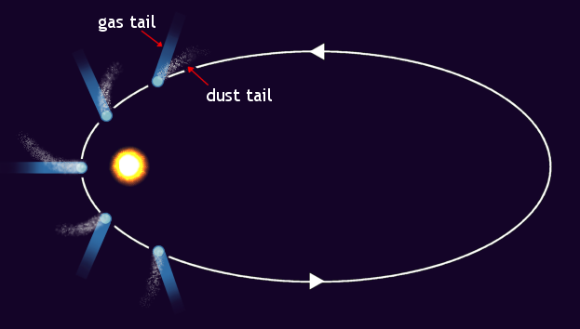
Orbit of Comets
The orbit of comets is very eccentric (elliptical)
The tail of the comet always points away from the sun.

Slide 14
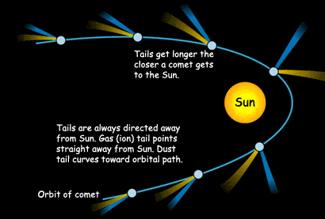
Orbit and Tail of Comet
When a comet gets close to the sun, the heat melts some of the ice in the comet and forms a long tail.
When a comet moves farther away from the sun the tail disappears.

Slide 15
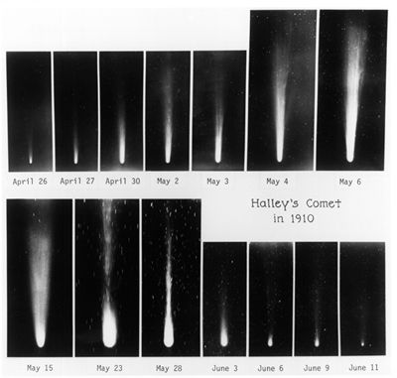
Tail Size during orbit

Slide 16
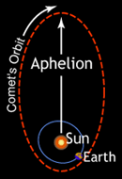
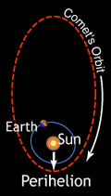
Aphelion and Perihelion
The point in an orbit closest from the sun is called the perihelion.
The point in an orbit farthest from the sun is called the aphelion.

Slide 17

Comet types
Short period | Period is less than 200 years. Those with periods of less than 20 years are believed to originate in the Kuiper belt. Others, e.g. Halley's comet, are thought to originate in the Oort cloud.
Long period | Period greater than 200 years to orbit the sun, some have a period of several million. All are believed to originate in the Oort cloud. They have highly elliptical paths.
Halley's Comet orbits the Sun once every 76 years.
Comet Kohoutek has a period of 75,000 years.

Slide 18
Where do Comets come from?
Originate from the cold outer solar system, basically the left over pieces of our solar system
Some scientists think comets come from a region called the Oort Cloud.
This is a huge spherical region that surrounds the entire solar system.
It holds millions of small pieces of ice and rock that slowly orbit the Sun.
Also came from the Kuiper belt.

Slide 19
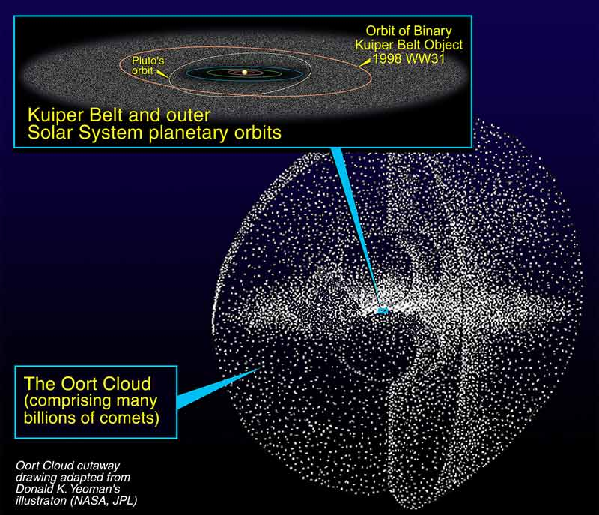

Slide 20
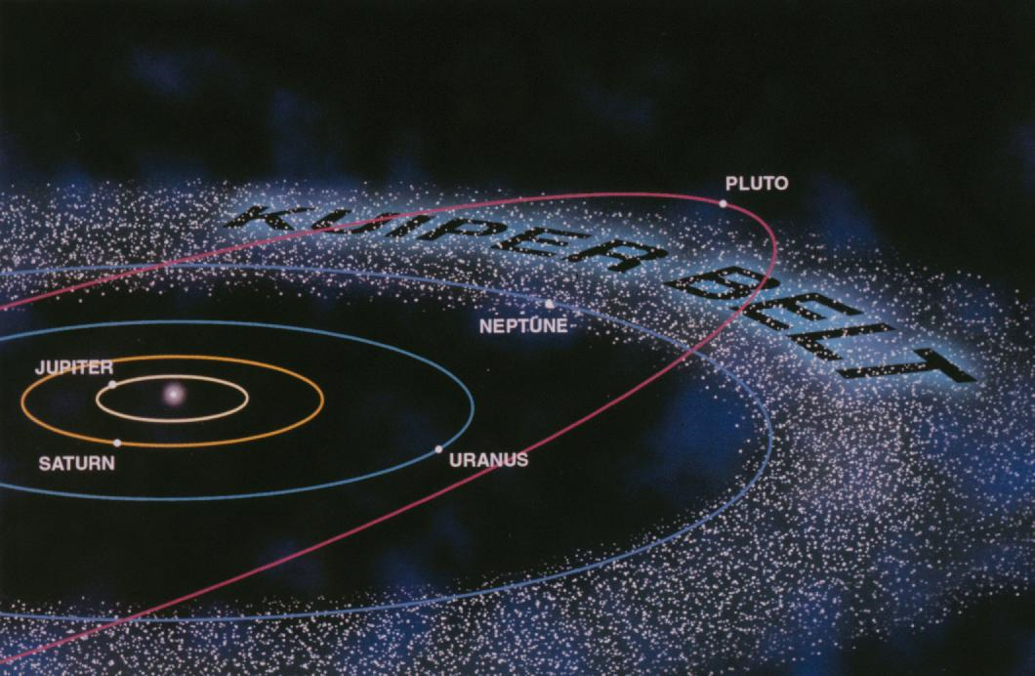
The Kuiper belt
In recent years astronomers have discovered that there is a belt of millions of small objects beyond Neptune from 30 AU to 50 AU.
Solar system formed from a disc of material around the Sun. The inner dense part of the disc formed the planets whilst the less dense outer part of the disc is what we know now as the Kuiper belt.
Many of the objects in the Kuiper belt are very large and some astronomers would classify Pluto (at 39 AU) not as a planet but just another Kuiper belt object.

Slide 21

The Oort cloud
The orbits of long-term comets suggest that they originate from a region about 50,000 AU from the Sun (a thousand times the orbit of Pluto!). They also come from all directions, not just from the same plane like Kuiper belt objects.
In 1950 Jan Oort suggested that there was an enormous spherical cloud surrounding our solar system, now called the Oort cloud. It would extend out into space perhaps to a distance of a light year and contain many millions of objects of different sizes. Again it may be remnants of the early solar system, perhaps the planetary nebula from which our solar system formed.

Slide 22
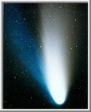
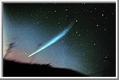
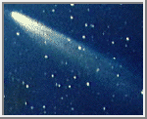
Pictures of Comets
Comet Hale-Bopp
Comet Kohoutek
Comet Ikeya-Seki

Slide 23
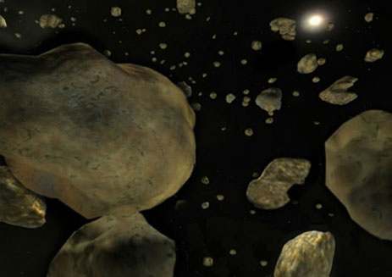
Asteroids and size
Asteroids are small bodies in orbit around the sun, made of rock and metal.
They range in size from a few meters <1km to more than >900 km in diameter - too small to be a planet.

Slide 24
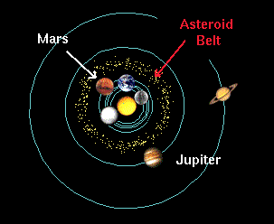
Asteroids Origin
Asteroid belt between Mars and Jupiter
Some asteroids that orbit planets are considered moons.
Some astronomers consider them to be minor planets (like the moons of Mars and Saturn).

Slide 25
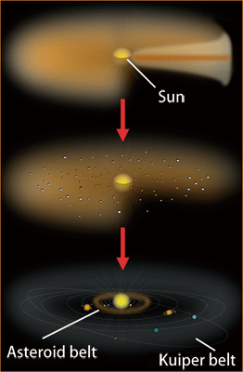
Asteroids Composition
Rocky objects left over from the formation of the solar system.

Slide 26
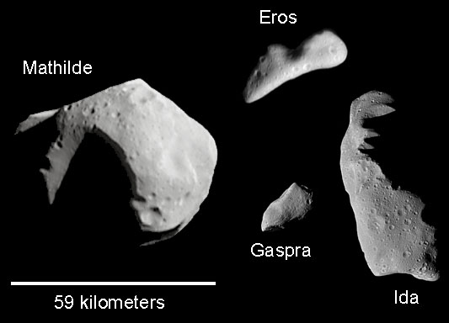
Asteroid Structure
Asteroids have irregular shapes, although some of the larger ones are spherical.
Using an infrared sensor, asteroids are classified as light or dark.
The lighter ones have more metal than the darker ones.

Slide 27
Asteroid Orbit and Special
Asteroids move in very elliptical orbits.
Orbits are mainly between Mars and Jupiter. (Asteroid Belt)

Slide 28
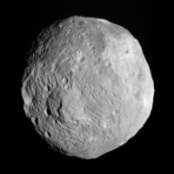
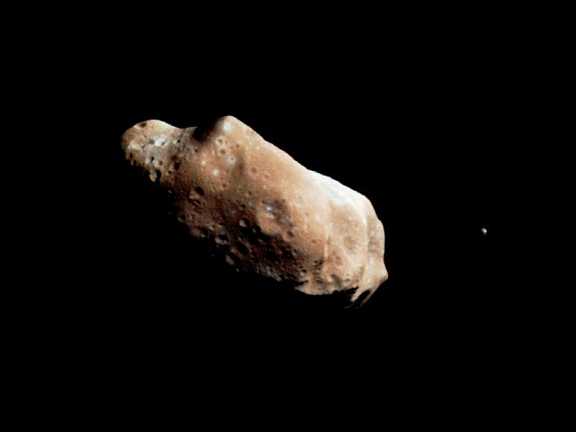
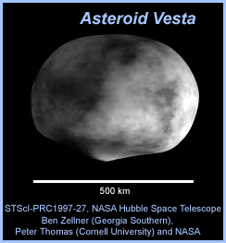
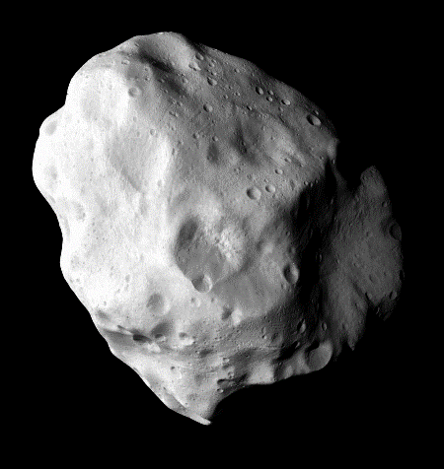
Special Asteroids
The largest are Pallas, Juno, and Vesta.
*Ceres was once called an asteroid, but is now a dwarf planet!

Slide 29

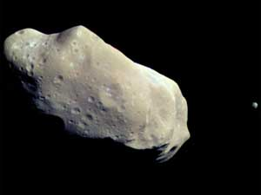
Special Asteroids
Remember, the largest asteroid in the asteroid belt is called Ceres.
  It is 580 miles across - the size of Texas, and is considered a dwarf planet.
Then there’s Ida, the first asteroid discovered to have a natural satellite, Dactyl.
  Both are heavily cratered by impacts with smaller asteroids and comets.
  Ida is about 56 km long and Dactyl is about 1.5 km

Slide 30
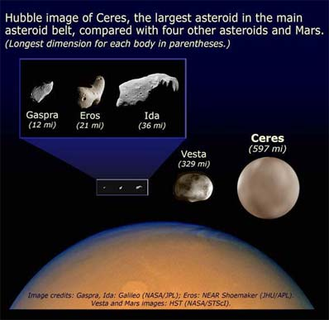
Ceres dwarf planet
Was an asteroid now a dwarf planet.
Obervation of 1, Ceres the largest known asteroid, have revealed that the object may be a mini planet and may contain large amounts of pure water and ice beneath its surface.

Slide 31
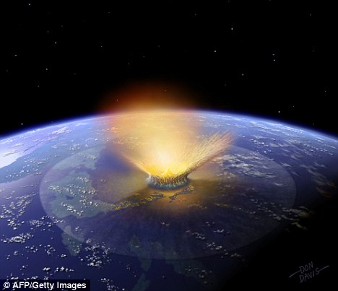
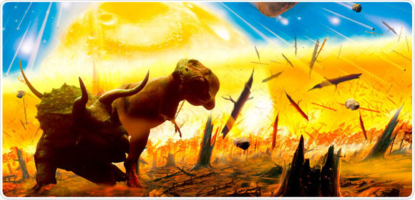
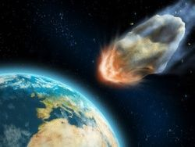
Hitting the Earth?
Scientists already think that a large asteroid may have hit the Earth when the dinosaurs were alive - about 65 million years ago.
That collision may have changed our atmosphere and led to the extinction of the dinosaurs.

Slide 32
Hitting the Earth?
There may come a day when one of those asteroids drops out of orbit (maybe from a collision with another asteroid) and heads toward Earth.
If it is small enough, it will burn up in the atmosphere.
Larger ones (over 10 km across) will hit the surface of the planet.
Hundreds of millions of years ago, collisions with asteroids happened more often.
Over time, the number of asteroids in the path of the Earth decreased and collisions became less frequent.

Slide 33
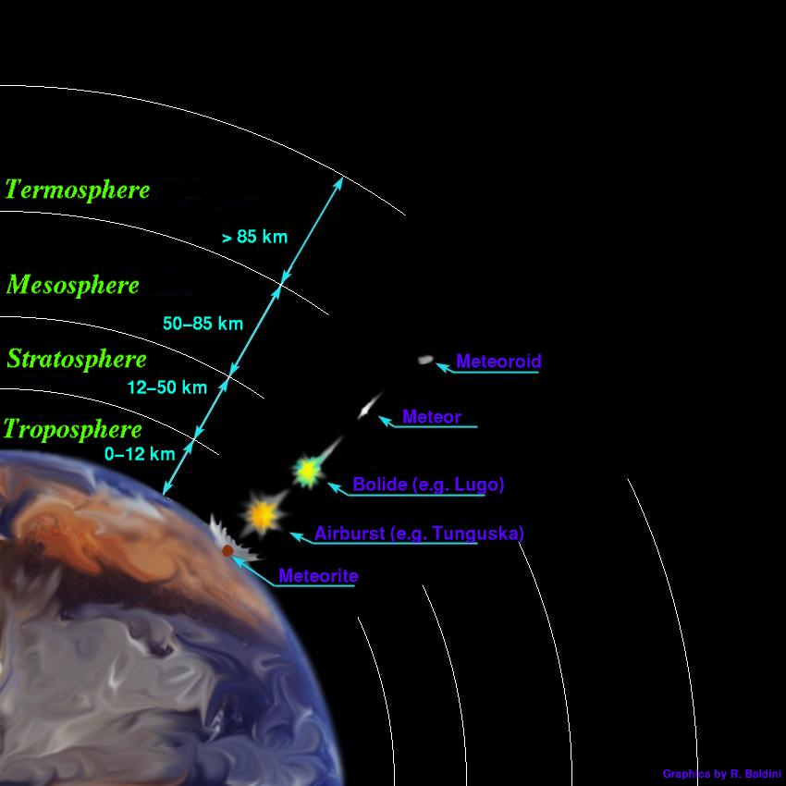
Meteoroids
A meteoroid is a rocky object that orbits the sun.
They are similar to asteroids but are much smaller.

Slide 34
Meteoroid, Meteorite, Meteor
The difference is just based on where the rock is located when you are describing it

Slide 35

Meteoroid is a “space rock” that is still in space
Meteor is a meteoroid that burns up in the earth’s atmosphere
(Shooting Star)
Meteorite is a meteoroid that hits
the earth’s surface

Slide 36

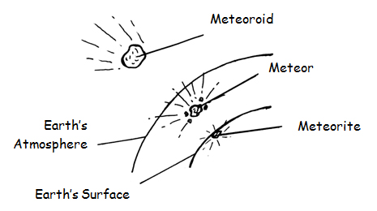

Slide 37
Meteoroids Origin
Meteoroids come from chunks of asteroid or comets that have broken off.

Slide 38
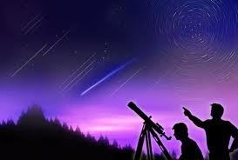
Meteoroids Size
Smaller than asteroids and comets from which they come from. (Since they are broken pieces of these).
The Perseid Meteor Shower (happens every August) which has been observed for 2000 years!

Slide 39
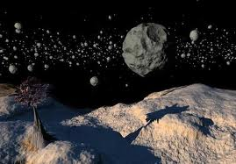
Meteoroids Composition
Rock
Dust

Slide 40
Meteor
As the meteoroid travels through the atmosphere, it becomes a meteor.
As the meteor travels through the atmosphere, it heats up to more than, 2,000˚C.
The intense heat vaporizes the meteor, creating a streak of light called a “shooting star”.
Sometimes, larger meteors cause a brighter flash called a fireball.
On average, a meteor can be seen in the night sky about every 10 minutes.

Slide 41
Meteor Showers
When a comet nears the sun, a trail of dust & debris burns off and remains in orbit around the sun.
As earth orbits the sun, it passes through the debris, causing a meteor shower as the small bits of dust burn up in the atmosphere.
During a meteor shower, you can see hundreds of meteors!
We can predict meteor showers because we know when the Earth passes through a comet’s path.

Slide 42
Meteorite
If a meteor is big enough to make it through the atmosphere and strike the Earth’s surface, it is called a meteorite.
We think meteorites are fragments from collisions involving asteroids.
Most meteorites weigh only a few pounds and cause little damage.

Slide 43
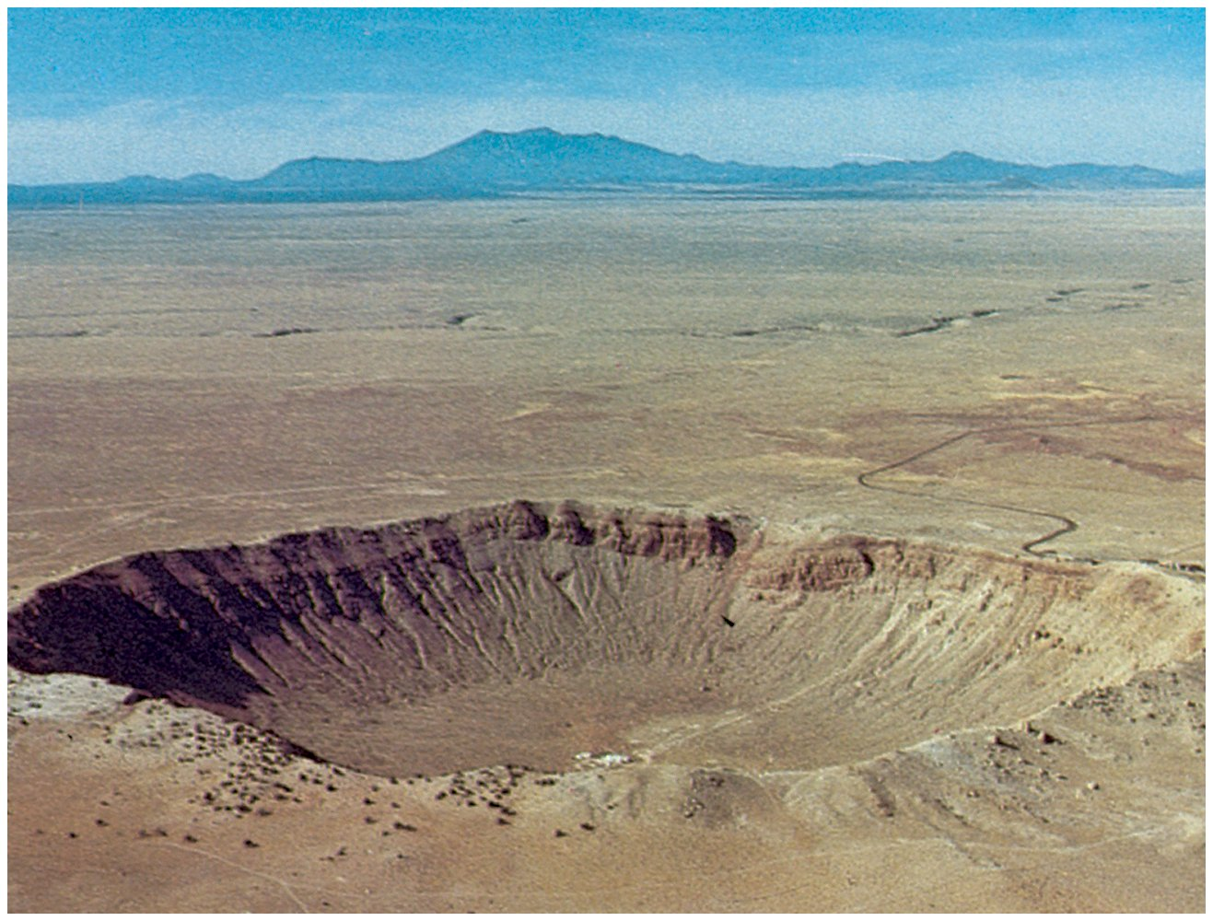
The moon & Mercury have many more impact craters than Earth or Mars because neither the moon or Mercury have a thick atmosphere to protect the surface from these impacts.
The easiest place in the world to find meteorites is in Antarctica.
Contrary to popular belief, there is very LITTLE snow fall there, and the snow never completely melts
So all you have to do to find them is walk out on a glacier and pick up rocks!

Slide 44
Types of Meteorites
Stony – Rocky Material
Metallic – Iron and Nickel
Stony Metallic – Rock material, Iron, and Nickel

Slide 45
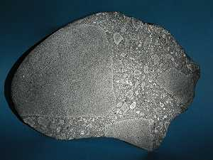
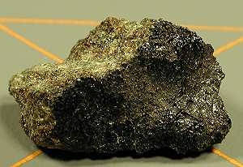
Stony Meteorites
Stony – Rocky Material

Slide 46
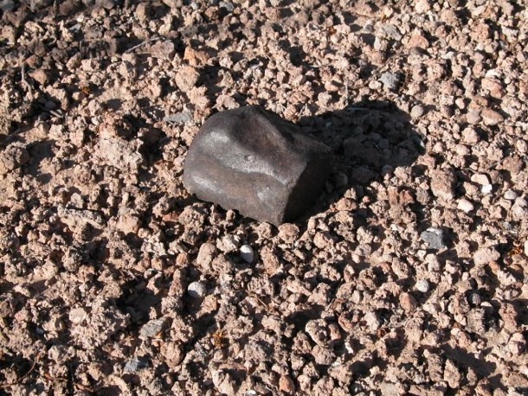
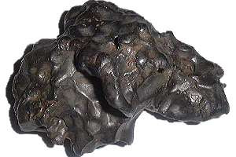
Metallic Meteorites
Metallic – Iron and Nickel

Slide 47
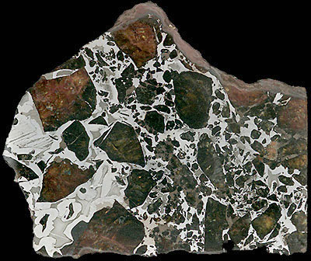
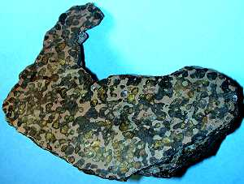
Stony Metallic Meteorites
Stony Metallic – Rock material, Iron, and Nickel

Slide 48
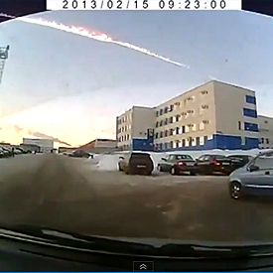
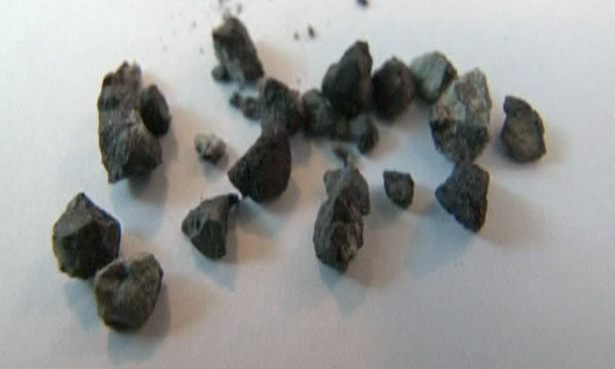
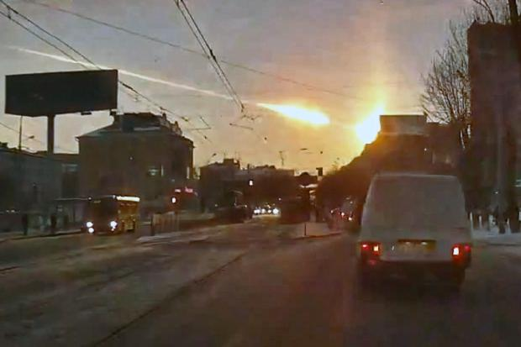
Meteorite hit Russia Video
https://www.youtube.com/watch?feature=player_detailpage&v=dpmXyJrs7iU
Feb. 15, 2013: A meteorite contrail is seen over Chelyabinsk. A meteor streaked across the sky of Russia’s Ural Mountains on Friday morning, causing sharp explosions and reportedly injuring around 1,000 people, including many hurt by broken glass.

Slide 49
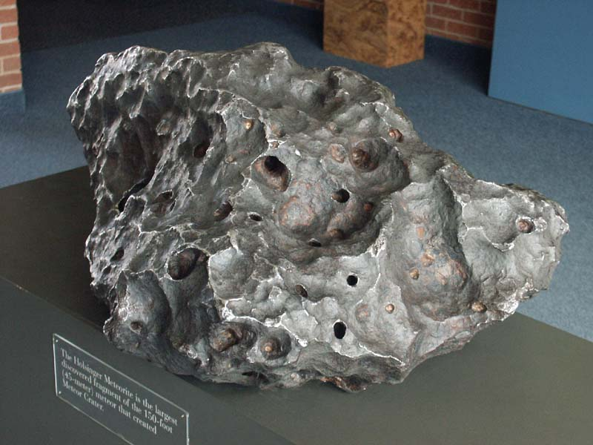
Meteorite Crater Sample

Slide 50
To know
Make sure you know the difference between:
  Comet
  Aphelion
  Perihelion
  Asteroid
  Meteoroid
  Meteor
  Meteorite

Slide 51
Big Ideas
Meteoroid – Chucnk of rock and dust in space.
Meteor – STREAK of Light made by meteoroid , burn up as it enters Earth’s Atmosphere.
  Shooting Star
Meteorite – A meteoroid that HITS the Earth.

Slide 52
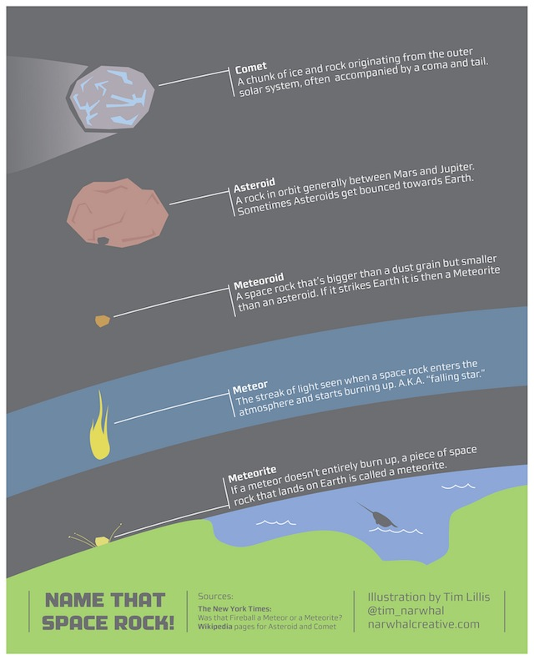
Big Ideas

